Slide 1
8.3 Symmetric, Skew-Symmetric,
and Orthogonal Matrices

Slide 2
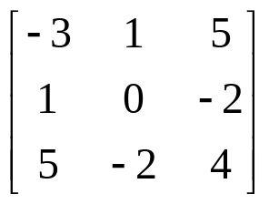
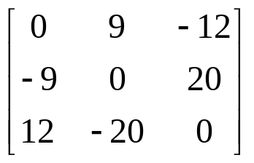
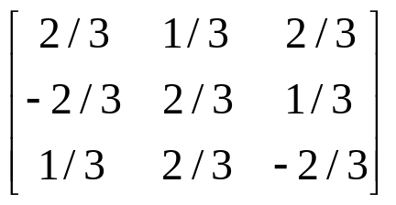
8.3 Symmetric, Skew-Symmetric,
and Orthogonal Matrices
Definitions
Symmetric, Skew-Symmetric, and Orthogonal Matrices
A real square matrix A = [a_{jk}] is called
symmetric if transposition leaves it unchanged,
(1) A^{T} = A, thus a_{kj} = a_{jk},
skew-symmetric if transposition gives the negative of A,
(2) A^{T} = −A, thus a_{kj} = −a_{jk},
orthogonal if transposition gives the inverse of A,
(3) A^{T} = A⁻¹, thus A^{T} A = AA^{T} = I
Example 1
Symmetric
Skew-symmetric
Orthogonal
Section 8.3 p<number>

Slide 3
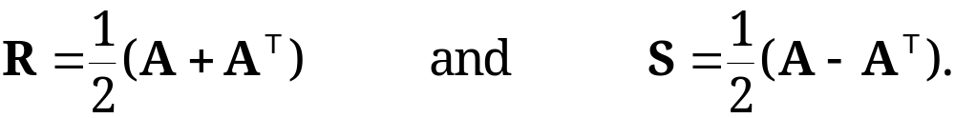
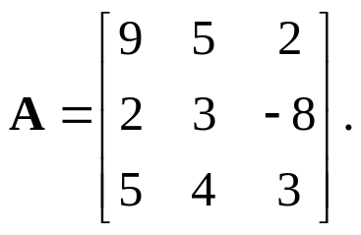
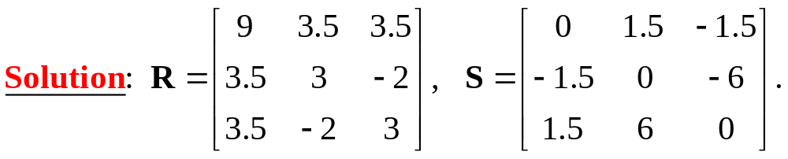
8.3 Symmetric, Skew-Symmetric,
and Orthogonal Matrices
Any real square matrix A may be written as the sum of a symmetric matrix R and a skew-symmetric matrix S, i.e.,
A = R + S
where (Question: why is this true??)
(4)
Example 2
Find a symmetric matrix R and a skew-symmetric matrix S such that A = R + S, where
Section 8.3 p<number>

Slide 4
8.3 Symmetric, Skew-Symmetric,
and Orthogonal Matrices
Theorem 1
Eigenvalues of Symmetric and Skew-Symmetric Matrices (Proof is optional and given in Section 8.5)
(a) The eigenvalues of a symmetric matrix are real numbers;
(b) The eigenvalues of a skew-symmetric matrix are pure
imaginary or zero.
Implication of Theorem 1:
A general real-valued square matrix may have both real and complex eigenvalues and eigenvectors
For symmetric and skew-symmetric matrix, however, we know something about their eigenvalues (and thus eigenvectors)
Section 8.3 p<number>

Slide 5
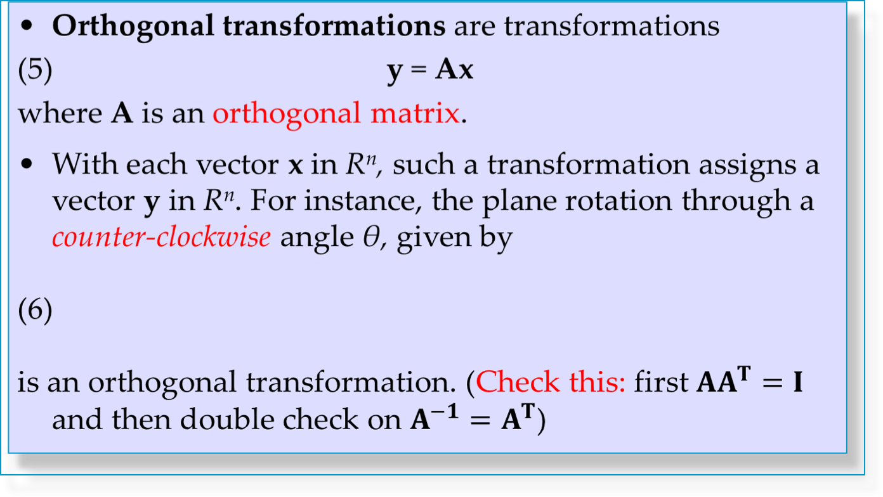
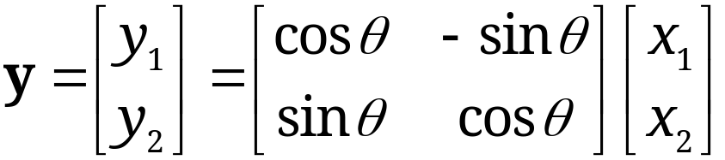
8.3 Symmetric, Skew-Symmetric,
and Orthogonal Matrices
Orthogonal Transformations and Orthogonal Matrices
Section 8.3 p<number>

Slide 6
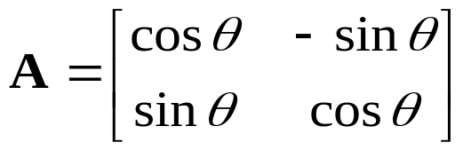

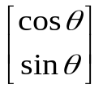
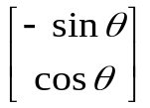

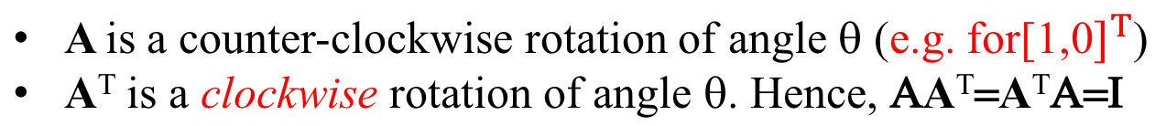
8.3 Symmetric, Skew-Symmetric,
and Orthogonal Matrices
X=R²
Y=R²
θ
θ
Any orthogonal transformation in the plane or in three-dimensional space is a rotation (possibly combined with a reflection in a straight line or a plane, respectively).
Section 8.3 p<number>

Slide 7
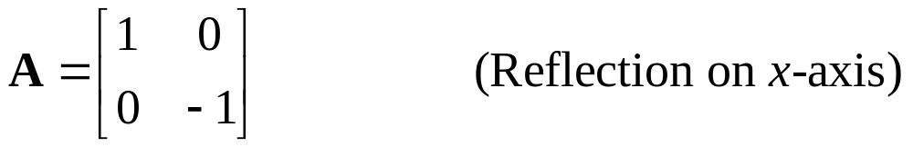

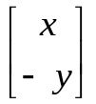
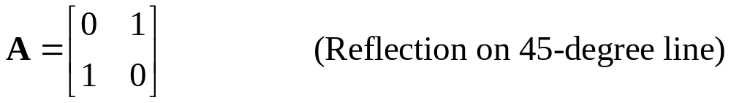

8.3 Symmetric, Skew-Symmetric,
and Orthogonal Matrices
More Examples of Orthogonal Transformations
X=R²
Y=R²
A
X=R²
A
Y=R²
Section 8.3 p<number>

Slide 8
8.3 Symmetric, Skew-Symmetric,
and Orthogonal Matrices
Remarks and Questions
Can a matrix be both symmetric and orthogonal ? Please give some examples.
Can a matrix be both skew-symmetric and orthogonal ? Please give some examples.
If a skew-symmetric matrix is invertible, is its inverse also skew-symmetric ?
Is an odd n sized skew-symmetric matrix invertible ?
Section 8.3 p<number>

Slide 9

8.3 Symmetric, Skew-Symmetric,
and Orthogonal Matrices
Remarks and Questions
Section 8.3 p<number>

Slide 10
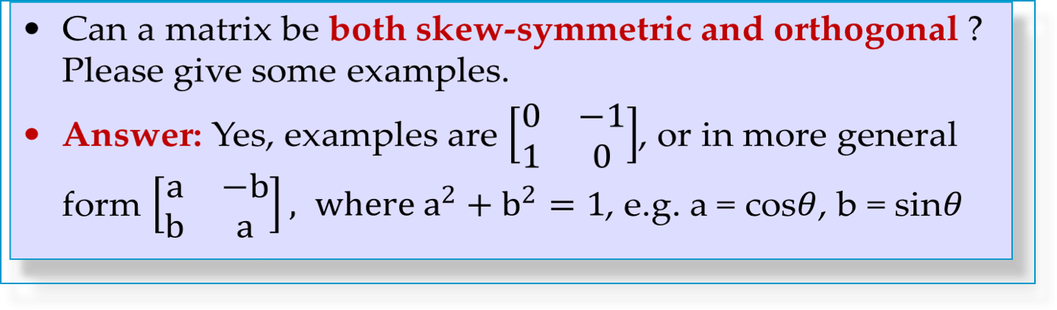
8.3 Symmetric, Skew-Symmetric,
and Orthogonal Matrices
Remarks and Questions
Section 8.3 p<number>

Slide 11
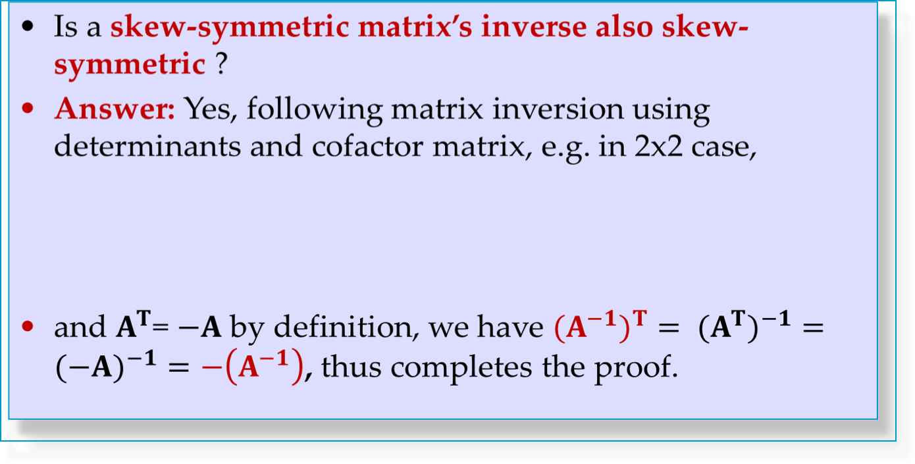
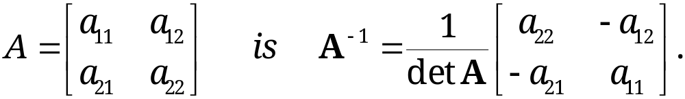
8.3 Symmetric, Skew-Symmetric,
and Orthogonal Matrices
Remarks and Questions
Section 8.3 p<number>

Slide 12
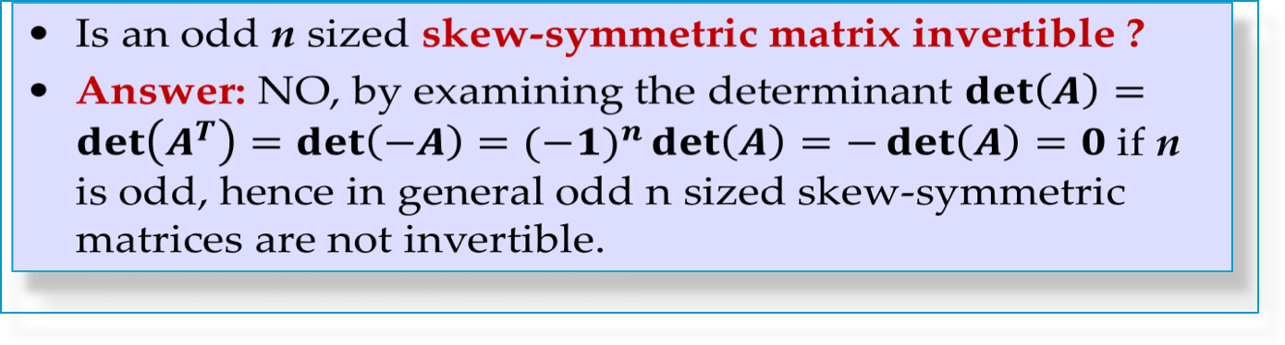
8.3 Symmetric, Skew-Symmetric,
and Orthogonal Matrices
Remarks and Questions
Section 8.3 p<number>

Slide 13
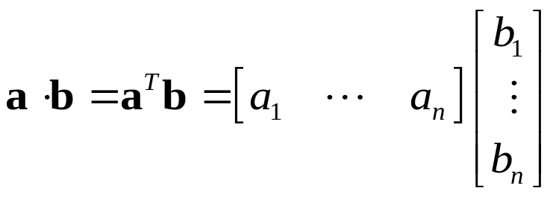
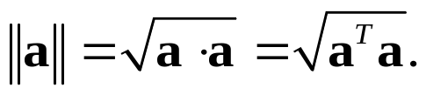
8.3 Symmetric, Skew-Symmetric,
and Orthogonal Matrices
Theorem 2 Property of Orthogonal Transformation
Invariance of Inner Product
An orthogonal transformation preserves the value of the inner product of vectors a and b in R^{n}, defined by
(7)
That is, for any a and b in R^{n}, n × n orthogonal matrix A, and u = Aa, v = Ab, we have u · v = a^{T} A^{T} Ab = a · b.
Hence the transformation also preserves the length or norm of any vector a in R^{n} given by
(8)
Section 8.3 p<number>

Slide 14
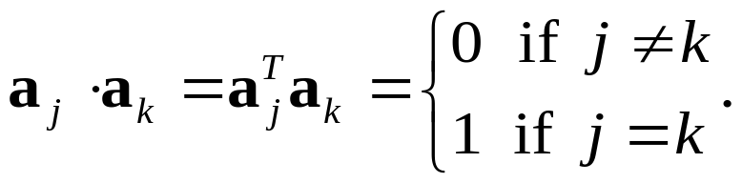
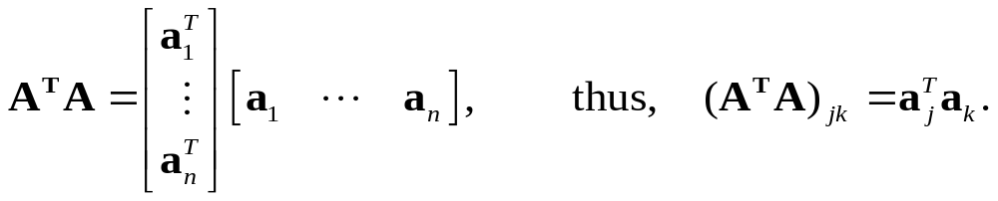
Theorem 3
8.3 Symmetric, Skew-Symmetric,
and Orthogonal Matrices
Orthonormality of Column and Row Vectors
A real square matrix is orthogonal if and only if its column vectors a₁, … , a_{n} (and also its row vectors) form an orthonormal system, that is,
(10)
Proof: Let A = [a₁ ∙ ∙ ∙ a_{n}], where a₁, ∙ ∙ ∙, a_{n} are n×1 column vectors. Then, we have
(11)
Theorem 3 follows from comparing A^{T}A with the unit matrix I.
Section 8.3 p<number>

Slide 15
8.3 Symmetric, Skew-Symmetric,
and Orthogonal Matrices
Theorem 4
Determinant of an Orthogonal Matrix
The determinant of an orthogonal matrix has the value +1 or −1.
Proof
From det (AB) = det A det B (Sec. 7.8, Theorem 4) and det A^{T} = det A (Sec. 7.7, Theorem 2d), we have
1 = det I = det (A A^{T}) = det A × det A^{T} = (det A)².
Thus, det A equals either 1 or -1.
Section 8.3 p<number>

Slide 16


8.3 Symmetric, Skew-Symmetric,
and Orthogonal Matrices
Theorem 5
Eigenvalues of an Orthogonal Matrix
The eigenvalues of an orthogonal matrix A are real or complex conjugates in pairs and have absolute value 1.
Proof: Let λ be an eigenvalue and x be an eigenvector corresponding to λ. Then, Ax = λx. Thus,
This shows that is also an eigenvalue of matrix A. In addition, we have
Thus, λ has absolution value 1 when A is orthogonal.
Section 8.3 p<number>

Slide 17
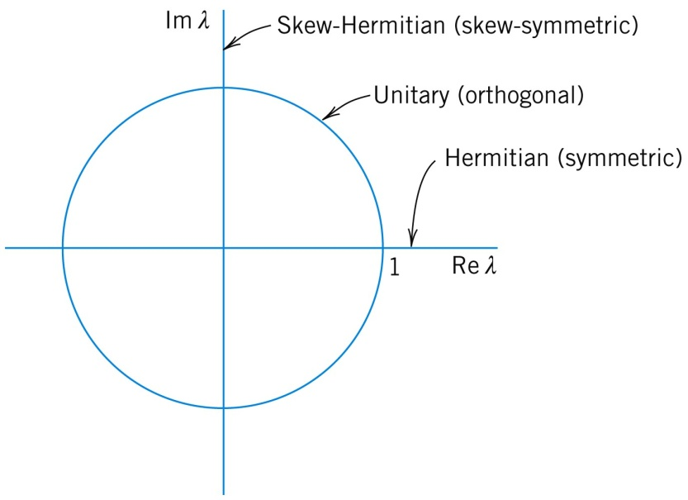
8.3 Symmetric, Skew-Symmetric,
and Orthogonal Matrices
Skew-symmetric
Orthogonal
Symmetric
Characterization of eigenvalues of symmetric,
skew-symmetric, and orthogonal matrices
Section 8.3 p<number>

Slide 18


Slide 19

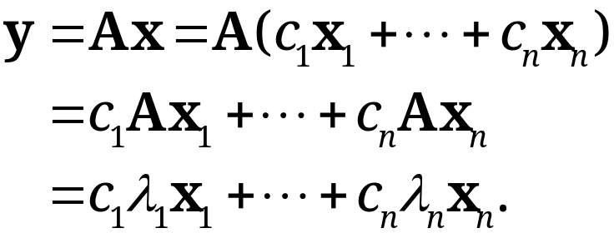
Eigenbasis
Eigenvectors of a general n × n matrix A may (or may not!) form a basis for R^{n}
If the eigenvectors of an n × n matrix A forms a basis for R^{n}, then it is called an “eigenbasis” (basis of eigenvectors)
Advantage of an “eigenbasis” (if it exists)
  We can express any x in R^{n} uniquely as a linear combination of the eigenvectors x₁, … , x_{n}, say,
  x = c₁x₁ + c₂x₂ + … + c_{n}x_{n}.
  Then,
  Hence, multiplication of A on an arbitrary vector x can be decomposed into a sum of simple actions on the eigenvectors of A. This is the point of eigenbasis.
Section 8.4 p<number>

Slide 20

Theorem 1
Basis of Eigenvectors
If an n × n matrix A has n distinct eigenvalues, then A has a basis of eigenvectors x₁, … , x_{n} for R^{n}.
Remark
More General Result
Suppose λ₁, … , λ_{m} are m distinct eigenvalues of an n × n matrix A, and x_{i1}, … , x_{iri} are linearly independent eigenvectors corresponding to eigenvalue λ_{i}, i=1, … , m. The eigenvectors
x₁₁, … , x_{1r1} , …, x_{m1}, … , x_{mrm}
are linearly independent.
Section 8.4 p<number>

Slide 21
Proof of Theorem 1
We need to show that x₁, … , x_{n} are linearly independent. Suppose they are not. Let r be the largest integer such that x₁, … , x_{r} are linearly independent. Then, r < n and
(2) x_{r+1} = c₁x₁+ … + c_{r}x_{r}.
Multiply both sides of (2) from left by A, we have
(3) λ_{r+1}x_{r+1} = c₁λ₁x₁+ … + c_{r}λ_{r}x_{r} .
Subtracting (3) by (2) × λ_{r+1}, we obtain
c₁(λ₁ - λ_{r+1})x₁+ … + c_{r}(λ_{r} - λ_{r+1})x_{r} = 0.
Since x₁, … , x_{r} are linearly independent, and λ₁, … , λ_{r+1} are distinct, we have c₁=…=c_{r}=0. Consequently, from (2), we have x_{r+1} = 0.
However, x_{r+1} ≠ 0 because it is an eigenvector. Contradiction! Hence, Theorem 1 is proved.
Section 8.4 p<number>

Slide 22
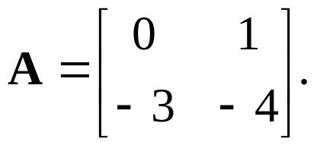
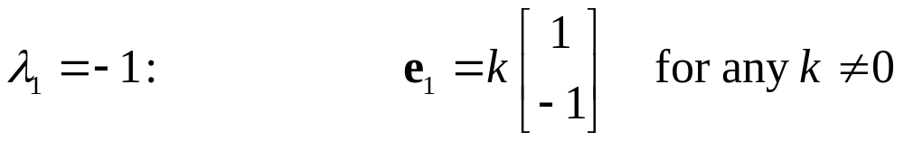
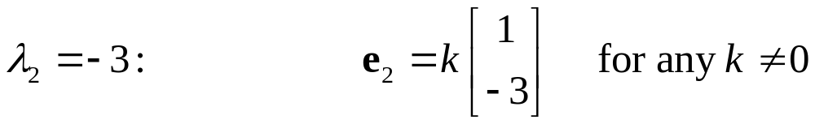
Example 1: General Matrix with Distinct Roots
Consider the matrix
It has two distinct eigenvalues: λ₁= −1 and λ₂= −3.
Eigenvectors form an eigenbasis. Verify.
e₁ and e₂ are linearly independent and thus form a basis for R²
Section 8.4 p<number>

Slide 23
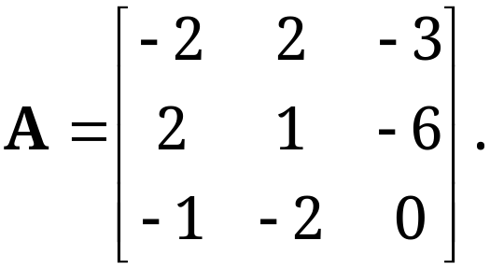
Example 2: General Matrix with Multiple Roots
(Revisit EXAMPLE 2 of Section 8.1)
Consider the matrix
The characteristic equation
−(λ +3)²(λ–5) = 0.
The roots (eigenvalues of A) are λ₁ = 5, λ₂ = λ₃ = −3.
Question: Do the eigenvectors form an eigenbasis for R³ ?
Multiplicity=2 for
this eigenvalue
Section 8.4 p<number>

Slide 24
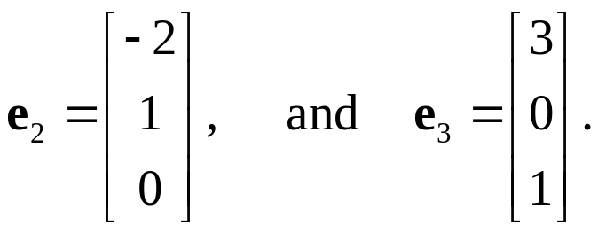
Example 2 (continued)
For λ = 5, e₁=[1 2 -1]^{T}
For λ = −3,
Thus, e₁ , e₂ , and e₃ form a basis for R^{3.}
Remark
In this example, for the eigenvalue λ = −3, the algebraic multiplicity = geometric multiplicity = 2, leading to the formation of an eigenbasis
This is NOT true for a general matrix with multiple eigenvalues.
Section 8.4 p<number>

Slide 25
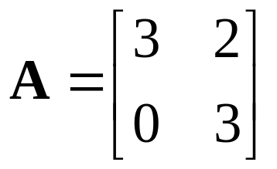
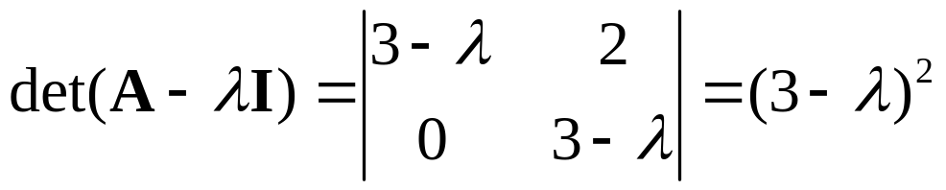
Example 3: General Matrix with Multiple Roots
(Revisit EXAMPLE 3 of Section 8.1)
Consider the matrix
The characteristic equation
The roots (eigenvalues of A) are λ₁ = λ₂ = 3.
Multiple eigenvalue case. Do the eigenvectors form an eigenbasis for R² ?
Multiplicity=2 for
this eigenvalue
Section 8.4 p<number>

Slide 26
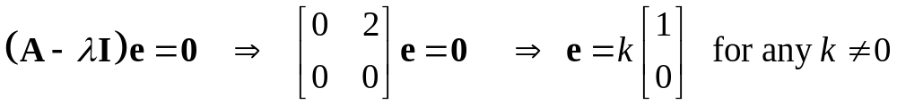
Example 3 (continued)
Eigenvectors: for λ₁ = λ₂ = 3,
  There is one eigenvector in this case, which cannot form a basis for R²! No eigenbasis!
  In this example, for the eigenvalue λ = 2, the geometric multiplicity is less than the algebraic multiplicity.
Remark
An n × n matrix A has a basis of eigenvectors x₁, … , x_{n} for R^{n} if and only if each eigenvalue of A has zero defect (i.e., its algebraic multiplicity equals its geometric multiplicity)
Section 8.4 p<number>

Slide 27
Theorem 2
Symmetric Matrices
An n×n symmetric matrix has an orthonormal basis of eigenvectors for R^{n}.
Remarks
An orthonormal basis is a basis where all the vectors are unit vectors and perpendicular to each other
An n×n symmetric matrix always has an eigenbasis for R^{n} regardless of whether it has distinct/multiple eigenvalues, which is NOT true for a general square matrix
Section 8.4 p<number>

Slide 28
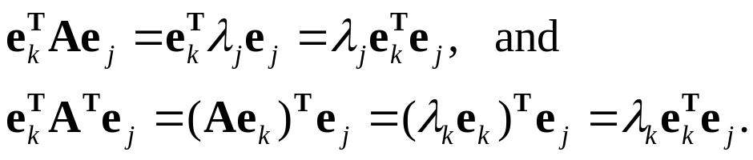

Proof of Theorem 2
The complete proof of Theorem 2 is complicated and can be decomposed into 2 (easier) parts: orthogonality and length normalization (can do for non-zero vectors). Now just prove:
For any symmetric matrix A, the eigenvectors corresponding to distinct eigenvalues are orthogonal.
Proof. Suppose e_{j} and e_{k} are eigenvectors of A corresponding to distinct eigenvalues λ_{j} and λ_{k}. Thus,
Since A is a symmetric matrix, it follows that
Since λ_{j}≠λ_{k} , we conclude that e_{j} and e_{k} are orthogonal.
Section 8.4 p<number>

Slide 29
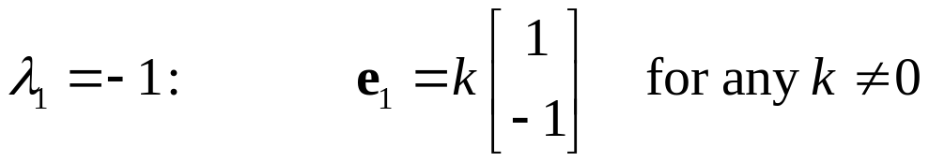

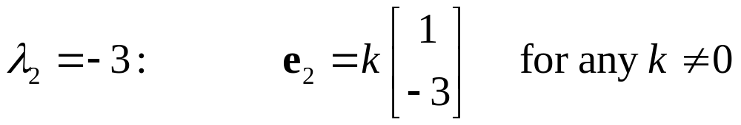
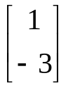
Revisit Example 1: General Matrix with Distinct Roots
Consider the matrix
It has two distinct eigenvalues: λ₁= -1 and λ₂= -3.
Eigenvectors form an eigenbasis.
e₁ and e₂ are linearly independent but NOT perpendicular
Section 8.4 p<number>

Slide 30

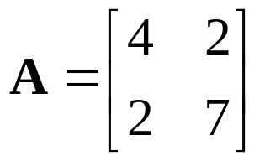

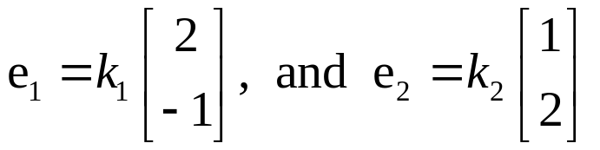

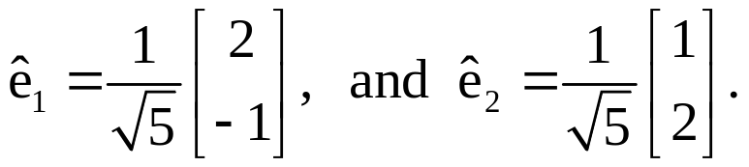
Example 3 Symmetric Matrix
Consider symmetric matrix
Eigenvalues are λ₁=3 and λ₂=8
The two eigenvalues are orthogonal, and
they form an orthogonal basis for R²
  Moreover, we can form an orthonormal basis by simply setting the values k₁ and k₂ to form unit length eigenvectors:
90º
Section 8.4 p<number>

Slide 31
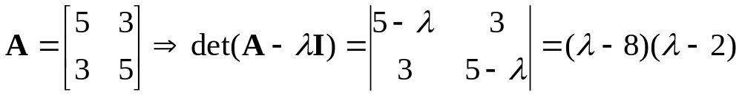

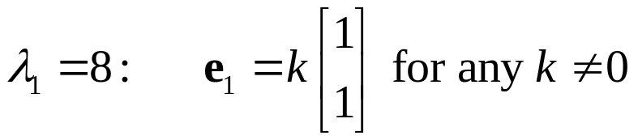
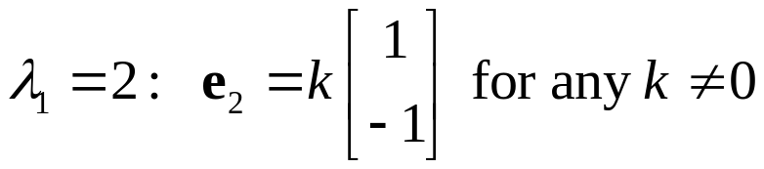
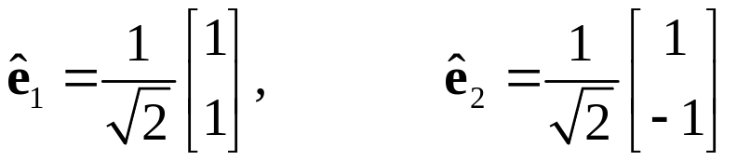
Example 4 Symmetric Matrix
(Revisit Example 1 of Section 8.2)
The matrix of an elastic membrance
Two eigenvalues
e₁ and e₂ are not only linearly independent, but also orthogonal. They can simply form an orthonormal eigenbasis for R² using the constant k to yield
90º
Section 8.4 p<number>

Slide 32
Nice Properties of Eigenvectors of Symmetric Matrix
For a symmetric matrix A, eigenvectors corresponding to distinct eigenvalues are always orthogonal – simpler in forming orthonormal basis
  If an eigenvalue λ of a symmetric matrix A is of algebraic multiplicity k, then
    The eigenspace corresponding to λ must be of dimension k
    Further, one can always construct an orthonormal basis for this k-dimensional eigenspace of λ
Section 8.4 p<number>

Slide 33
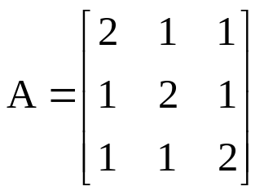
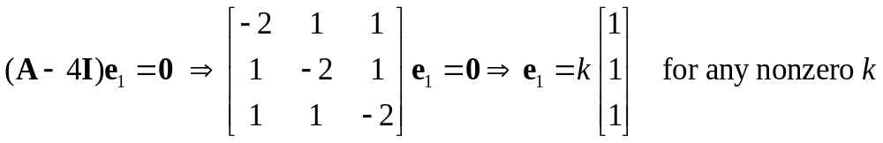
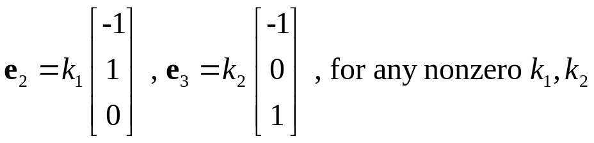
Example 5 Symmetric Matrix
Consider the matrix
Characteristic equation: |A - λ I|=0
Eigenvalues: λ₁=4, λ₂=λ₃=1 (multiplicity = 2)
Eigenvector corresponding to λ₁=4,
Eigenvector corresponding to λ₂=λ₃=1,
Section 8.4 p<number>

Slide 34
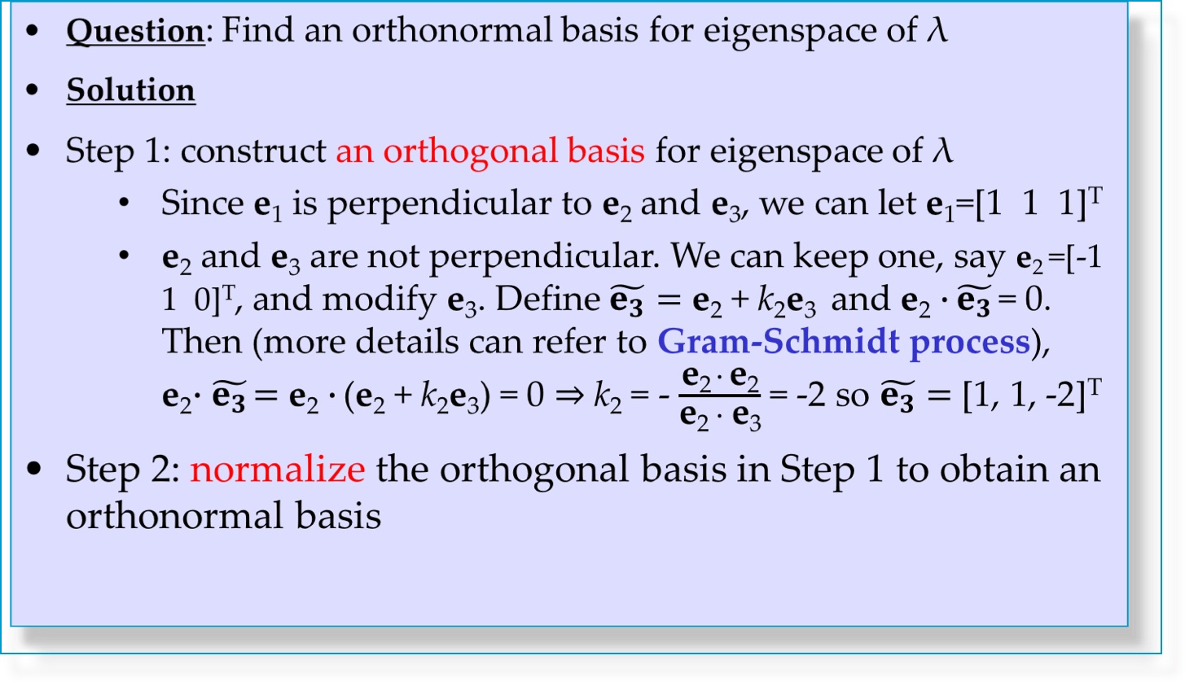
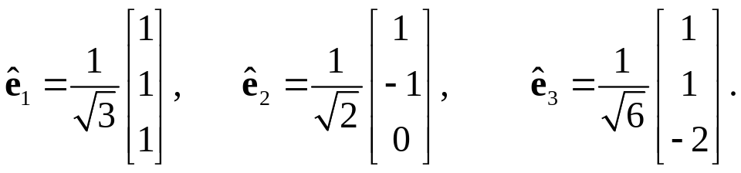
Example 5 Symmetric Matrix (continued)
Gram-Schmidt process: https://en.wikipedia.org/wiki/Gram%E2%80%93Schmidt_process
Section 8.4 p<number>

Slide 35
Similarity of Matrices. Diagonalization
DEFINITION
Similar Matrices. Similarity Transformation
An n × n matrix Â is called similar to an n × n matrix A if
(4) Â = P⁻¹AP
for some nonsingular n × n matrix P.
The transformation P, which gives Â from A, is called a similarity transformation.
Section 8.4 p<number>

Slide 36

The key property of similarity transformation is that it preserves the eigenvalues of A
Theorem 3
Eigenvalues and Eigenvectors of Similar Matrices
If Â is similar to A, then Â and A have the same eigenvalues.
Furthermore, if x is an eigenvector of A, then y = P⁻¹x is an eigenvector of Â corresponding to the same eigenvalue.
Section 8.4 p<number>

Slide 37
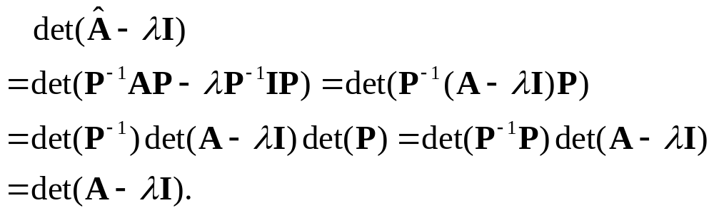
Proof of Theorem 3
Recall that to prove two matrices have the same eigenvalues, we only need to show that they have the same characteristic determinant.
This is shown by observing that
Suppose λ is an eigenvalue of A and x is its eigenvector. Then, A x= λx. From the definition of Â, we have
Thus, P⁻¹x is an eigenvector of the eigenvalue λ.
Section 8.4 p<number>

Slide 38
Definition
Diagonalizable Matrices
An n × n matrix A is diagonalizable if it is similar to a diagonal matrix.
Theorem 4
Diagonalization of a Matrix
If an n × n matrix A is diagonalizable if and only if it has a basis of eigenvectors. In addition, if A is diagonalizable, then
(5) D = X⁻¹AX
is a diagonal matrix, with the eigenvalues of A as the entries on the main diagonal. Here, X is the matrix with the corresponding eigenvectors as column vectors. Also,
(5*) D^{m} = X⁻¹A^{m}X (m = 2, 3, … ).
Section 8.4 p<number>

Slide 39
Proof of Theorem 4
We first prove the “if” part. Suppose A has an eigenbasis consisting of column vectors x₁, x₂, …, x_{n}, and the corresponding eigenvalues are λ₁, λ₂, …, λ_{n}. Then, A x_{k} = λ_{k} x_{k}, k =1, …, n. Define matrix X=[x₁, x₂, …, x_{n}]. Then, X is nonsingular and X⁻¹ exists. In addition, define D as the diagonal matrix with main diagonal entries being λ₁, λ₂, …, λ_{n}. Then, we have
AX=XD, and thus, D=X⁻¹AX.
We next prove the “only if” part. Suppose A is diagonalizable. Then, there exists a nonsingular matrix P such that AP=PD, where D is a diagonal matrix with main diagonal entries being λ₁, λ₂, …, λ_{n}. By expanding AP=PD, the kth column is
A p_{k} = λ_{k} p_{k}, and thus p_{k} is an eigenvector of A.
Then, since P is nonsingular, p₁, p₂, …, p_{n} are an eigenbasis of A.
(5*) directly follows from associatitivity of matrix multiplication
Section 8.4 p<number>

Slide 40

Remarks
A general square matrix may or may not be diagonalizable, which depends on whether it has a engibasis
Symmetric matrices are always diagonalizable because of Theorem 2
Similarity transformation preserves the diagonalizability of a matrix (since A ~ B and A ~ C implies B ~ C)
Matrix Power A^{m} when A is diagonalizable
  A^{m} = XD^{m}X⁻¹, where
Section 8.4 p<number>

Slide 41


EXAMPLE 6 Diagonalization and Matrix Power
Revisit Example 5
Calculate A¹⁰⁰
Solution:
Step 1: diagonalization
Eigenvalues: λ₁ = 4, λ₂ =λ₃ = 1
Eigenvectors: for λ₁ , λ₂ , and λ₃
Section 8.4 p<number>

Slide 42




EXAMPLE 6 (continued)
Thus,
Calculate X⁻¹ by Gauss-Jordan elimination or by determinants
Step 2: matrix power A¹⁰⁰
Section 8.4 p<number>

Slide 43
Announcements
Assignment 2 is now released, due on 6:30PM, Mar 10
Submission to collection box C18 @ 5/F of ERB

